Slide 1
14
12
DAVIS NAVEL
10
8
LESION DIAMETER (mm)
6
4
2
0
0
1
2
3
4
5
6
DAYS POST-INNOCULATION
14
GRAPE
12
10
8
esculentum
LESION DIAMETER (mm)
6
F1
4
hirsutum
2
0
0
1
2
3
4
5
6
DAYS POST-INNOCULATION
14
FRESA S.D.
12
10
8
LESION DIAMETER (mm)
6
4
2
0
0
1
2
3
4
5
6
14
DAYS POST-INNOCULATION
12
RASPBERRY
10
8
LESION DIAMETER (mm)
6
4
2
0
0
1
2
3
4
5
6
DAYS POST-INNOCULATION

Slide 2
0.75
0.60
0.45
Dominance of Resistance
0.30
0.15
0.00
Day 2
Day 3
Day 4
Overall

Slide 3
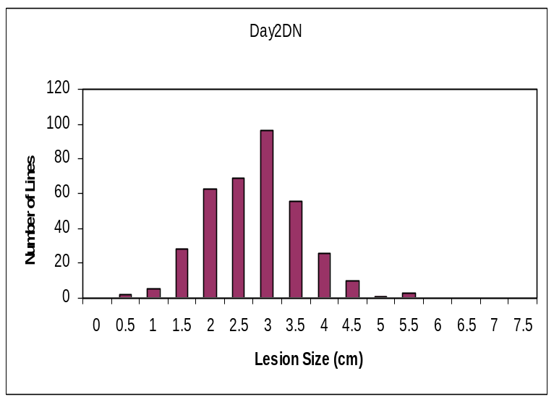
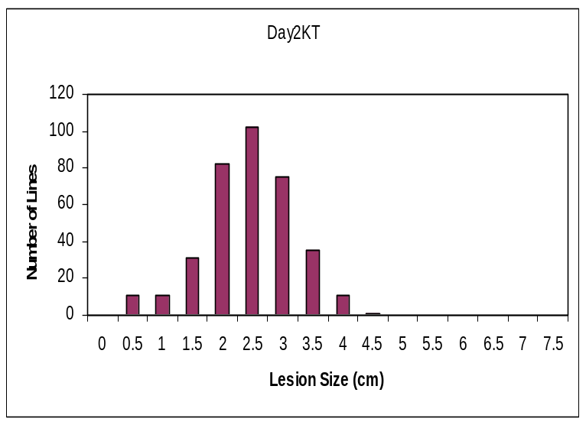
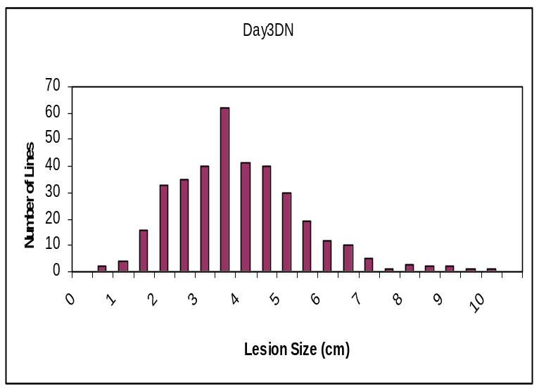
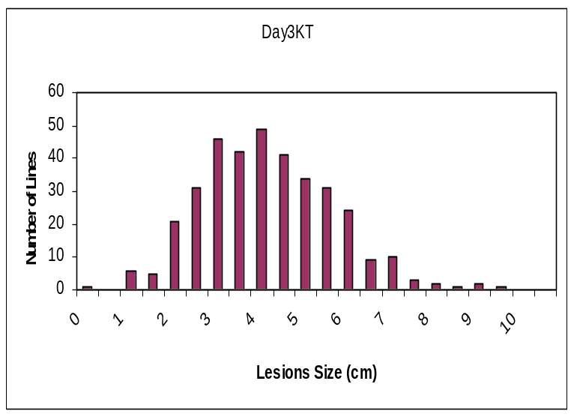
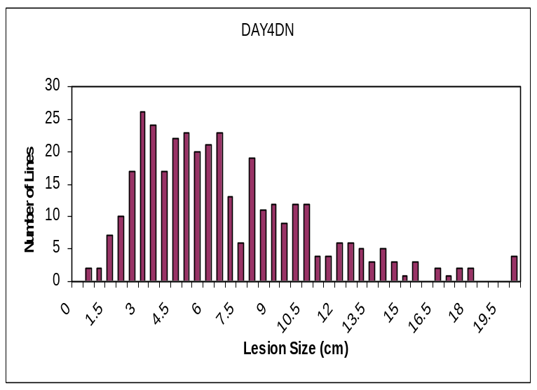
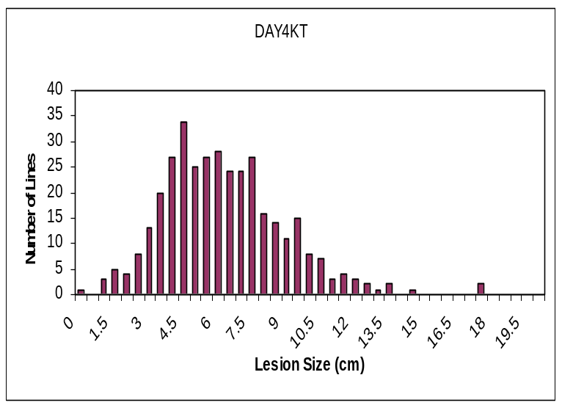
A
B
Hir
T5
Hir
T5
C
D
Hir
T5
Hir
T5
E
F
Hir
T5
Hir
T5

Slide 4
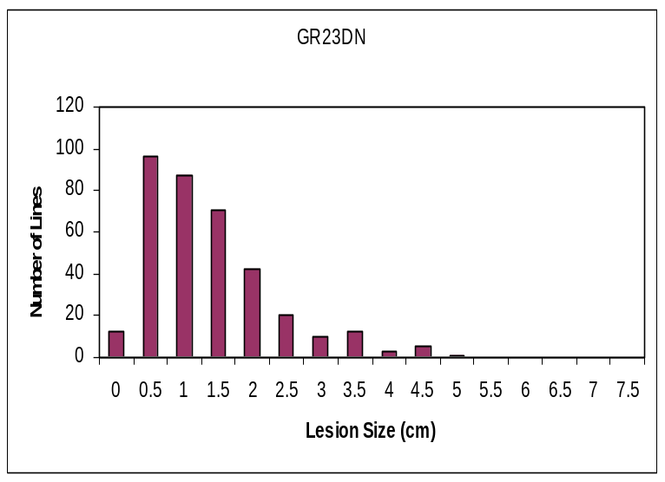
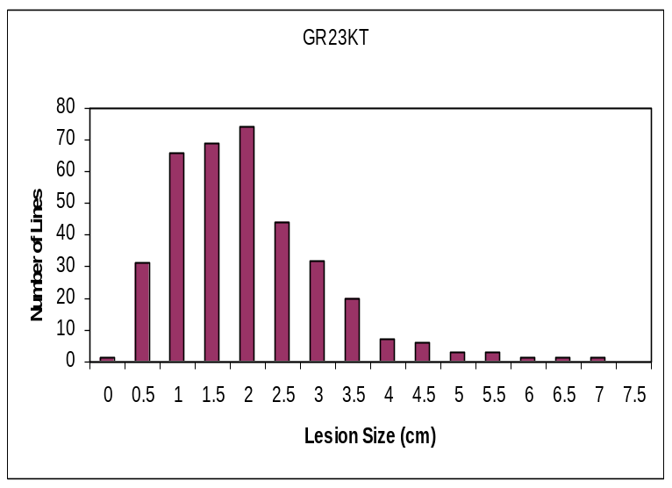
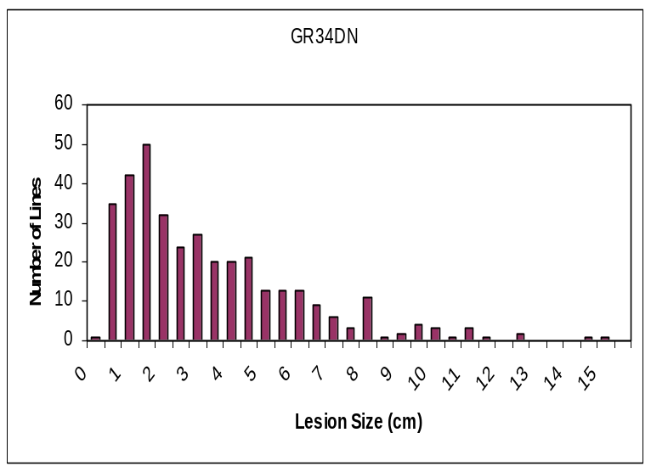
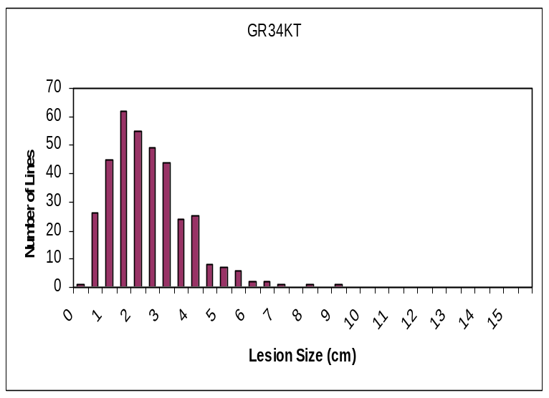
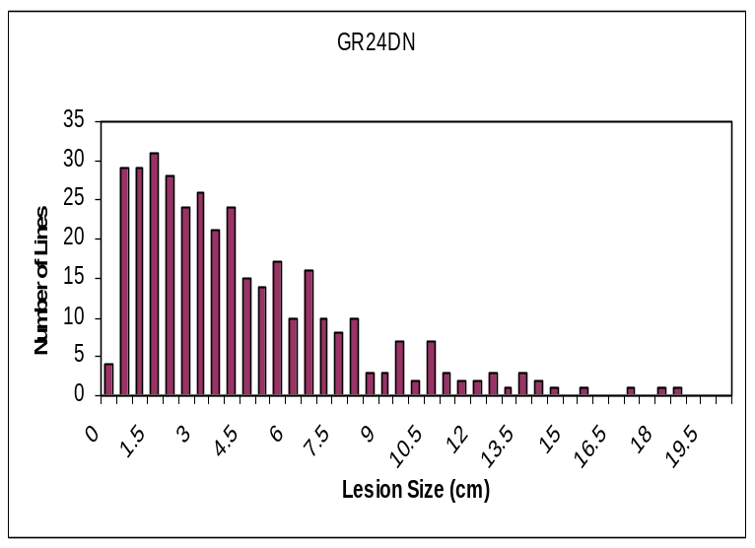
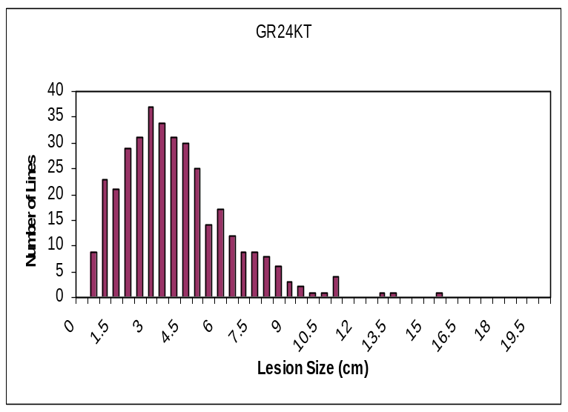
A
B
Hir
T5
Hir
T5
C
D
Hir
T5
Hir
T5
E
F
Hir
T5
Hir
T5

Slide 5
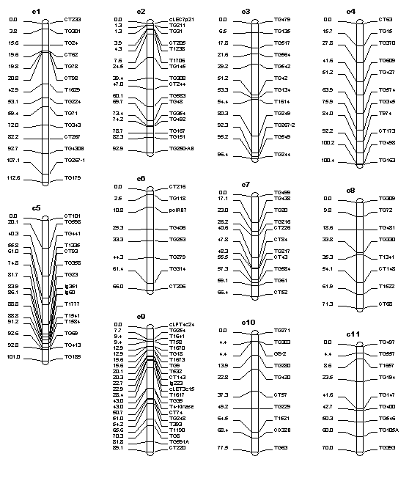
Davis Navel
2-A
= Growth Rate QTL
24 = Day4 v Day2
23 = Day3 v Day2
34 = Day4 v Day3
-1 = Experiment 1
-2 = Experiment 2
-3 = Experiment 3
-M = MultiTrait QTL
-A = Average QTL
24-M
24-1
34-1
3-M
4-1
= Lesion Size QTL
2 = Lesion Size on Day2
3 = Lesion Size on Day3
4 = Lesion Size on Day4
-1 = Experiment 1
-2 = Experiment 2
-3 = Experiment 3
-M = MultiTrait QTL
-A = Average QTL
23-A
23-2
23-M
3-A
3-2
3-M
4-M
23-M
24-A
24-M
34-A
34-M
34-2
3-2
4-A
4-2
24-A
24-M
24-1
24-2
34-A
34-M
34-1
34-2
23-A
23-M
23-1
23-2
4-A
4-M
4-1
4-2
3-A
3-M
3-2
2-A
2-M
24-A
24-2
4-2
24-A
24-M
24-2
34-A
34-M
34-1
34-2
4-A
4-M
4-1
4-2
23-M
23-1
2-A
2-M
2-1
3-M
3-1

Slide 6
Katie Tomato
2-M
2-2
2-3
24-M
24-1
34-A
34-M
34-1
23-M
23-1
4-A
4-M
4-1
3-M
3-1
2-A
4-M
3-M
24-A
24-M
24-3
34-M
34-3
23-A
23-M
23-3
24-A
24-M
24-1
24-2
24-3
34-A
34-M
34-3
4-M
4-3
3-M
3-3
23-A
23-M
23-1
23-2
4-M
4-1
4-3
3-M
3-1
3-3
2-A
2-M
24-M
2-M
2-2
24-A
23-A
3-1
23-M
23-2
2-A
2-M
2-3

Slide 7
A
B
TG71
TG194
GR^{23,34,24}
TG498
TG71
TG194
TG498
GR^{23,34,24}
D^{2,3,4}
GR³⁴
GR^{34,24}
D⁴
GR³⁴
D^{2,3,4}
GR^{34,24}
TG420
D³
TG542
D^{2,3}
TG249
TG420
TG542
D^{2,3}
TG249
D^{2,3}
GR^{34,24}
D^{2,3,4}
D²
GR²³
D^{2,3}
D^{2,3}
GR^{34,24}
D^{2,3,4}
D²
GR²³
D^{2,3}
TG78
D^{2,3}
TG1584
TG78
D²
TG1584
C
D
TG194
GR^{23,24} D^{2,4}
TG303
TG194
GR^{23,24} D^{2,4}
TG303
D⁴
D⁴
GR²⁴
D^{2,3}
D²
D⁴
D⁴
D³
TG481
GR^{23,24}
TG430B
TG481
TG430B
GR²⁴
D³
D²
D^{2,3}
GR²⁴
D³
D^{2,3}
TG35
GR³⁴ D³
TG584
GR³⁴ D^{3,4}
TG1584
TG35
TG584
GR³⁴ D^{3,4}
TG1584
GR^{23,24}
GR^{23,24}
TG249
TG249
GR^{23,24}

Slide 8
18
16
14
12
10
Frequency of Epistatic
Interactions
8
6
4
2
0
RRS
RSS
RSR
SRS
SSR
SRR
Genotype (H/H, H/T, T/T)
18
16
14
12
10
Frequency of Epistatic
Interactions
8
6
4
2
QTL1
0
Het
QTL2
Het
T5
Het
Genotype
Het
T5
T5
T5
Mean B. cinerea lesion size for pairwise allele combinations

